Slide 1

TEAM: TECH TITANS
Suyash Das
Mayuresh Sharma
Dhruv Choudhary
Yashi Goyal
Tishika Jaiswal

Slide 2
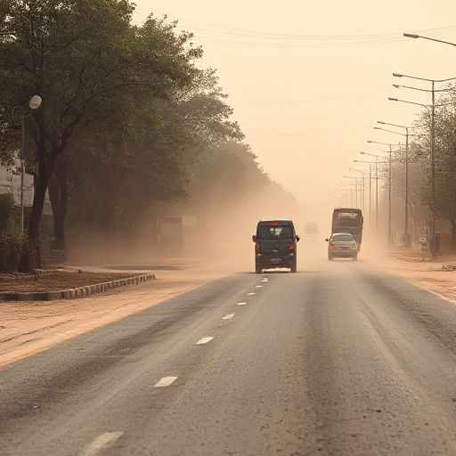

<PROBLEM STATEMENT CHOSEN>
“Use tech skills to create impactful solutions“
~Controlling Air Pollution on roads

Slide 3
WHERE’S THE PROBLEM?
In 2024, air pollution was linked to approximately 1.6 million premature deaths in India, according to the Global Burden of Disease report. This figure underscores the severe impact on public health.
In 2023, the World Bank estimated that air pollution in India caused economic losses amounting to approximately $150 billion USD, which is roughly 5% of the country’s GDP. This figure includes Health costs ,Lost labor productivity and Environmental and agricultural damage.

Slide 4
According to a study by IIT Delhi and IIT Kanpur, 55% of Indian states have road dust levels higher than the World Health Organization (WHO) standards. Road dust contributes to 30 to 60% of PM10 and PM2.5 level pollution in major cities of the country.
Road pavements act as both accumulators and sources of road dust, which can contain a mixture of tailpipe exhaust emissions, ambient air pollutants, as well as particles from tyre and brake wear, and road surface degradation. These accumulated pollutants can later become resuspended, contributing to the overall particulate matter in the air resulting in significant health effects

Slide 5


Smart Air Purification Network
Revolutionizing Urban Air Quality Through Intelligent Infrastructure

Slide 6
Problem – Air Pollution crisis
(demands innovative and sustainable solutions)
Our Solution -
Transforming city’s streetlight infrastructure into “smart air purification network”
By Integrating
"AQI (Air Quality Index) and PPM (Parts Per Million) sensors, automated sprinklers, and particulate matter collection.
Sprinklers installed on extended arms above streetlights will release fine water mist, effectively settling particulate matter (PM) and improving air quality on roads

Slide 7
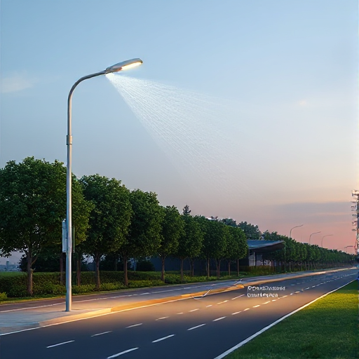

Functioning:
AQI and ppm conc. of particulate matter is constantly measured by sensors and recorded
Water sprinkler
If the value exceeds allowed limit, mist is automatically released by sprinklers of all connected lights.
AQI sensor
Suspended particles are settled on ground, thus improving air quality
Particulate matter settles down

Slide 8




TECH USED
C
Django
Next.js

Slide 9
Key Features and Functionality
Real-Time Monitoring and Automation:
-AQI and PPM sensors continuously monitor air quality in specific areas.
- When pollution levels exceed predefined thresholds, the system automatically activates sprinklers to release a fine water mist.
- The mist binds to airborne particulate matter, causing it to settle on the ground or nearby surfaces.
Enhanced Sprinkler Design:
- Extended Sprinkler Placement: Sprinklers are installed on arms positioned slightly above the streetlights to ensure wide water coverage. This height minimizes slipperiness on the roads while effectively reducing airborne pollutants.
- Precision Nozzles: Sprinklers disperse water in the form of a fine mist, ensuring maximum spread and reducing water wastage.

Slide 10
Mobile Application Integration:
-Real-time AQI data and sprinkler schedules accessible through user app
-Route planning with Google Maps integration showing active purification zones
Sustainable and Cost-Effective Design:
-Utilizes existing streetlight power infrastructure
-Smart activation and precision nozzles minimize water consumption
Safety and Durability:
-Waterproof coating protects electrical components
-Anti-drip system prevents water wastage and ensures safety
Data Collection for Optimization:
- Pollution data collected by sensors helps identify hotspots and optimize sprinkler schedules for maximum effectiveness.

Slide 11
Benefits of the Solution
Cleaner and Healthier Air
Sustainable and cost-effective
Improved Urban Aesthetics
Long Term Impact
Real Time Citizen Engagement

Slide 12
Scalability and Adaptability
This system can be installed in high-traffic or high-pollution areas of Metropolitan cities and other urban regions facing similar challenges.
The modular design of sprinklers, green walls, and particulate collectors ensures flexibility and adaptability to different city layouts.
Temperature measurement can be integrated with this model and same can be displayed on user application.

Slide 13
User Interface
# CITIZEN
Allows user to see real time AQI data and sprinkling schedules for different zones.
Displays analytics like weekly comparisons, peak hours etc.
# PROFESSIONAL
Allows worker to monitor detailed, region wise street light networks and water usage.
Allows them to operate sprinklers manually, if required and check for any faults.

Slide 14
Conclusion
This smart, streetlight-integrated air pollution mitigation system offers a comprehensive, sustainable, and innovative solution to address India’s air quality crisis. By combining real-time monitoring, advanced sprinkler designs, green infrastructure, and citizen engagement through mobile technology, this solution significantly reduces air pollution while ensuring long-term benefits for urban environments.

Slide 15
Team Member Details
Team Leader : Suyash Das BTech | (CSE) | 1st Year
Team Member 1: Mayuresh Sharma BTech | (CSE) | 1st Year
Team Member 2: Dhruv Choudhary BTech | (ECE) | 2nd Year
Team Member 3: Yashi Goyal BTech | (CSE) | 1st Year
Team Member 4: Tishika Jaiswal BTech | (CSE) | 1st Year

Slide 16

THANKYOU
Let us make a sustainable society ..

